Slide 1
Linear model theory
Interactions

Slide 2
Capturing “it depends”

Slide 3
The question

Slide 4
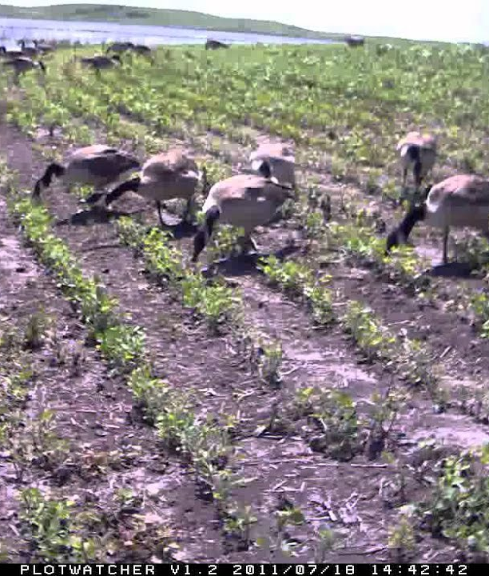
Human wildlife conflicts
Global needs:
  Increase food production
  Increase biodiversity
These two aims can conflict
While biodiversity in decline, some species have seen huge growth rates
Resulting in damage to crops
Need for information to help guide decision making

Slide 5
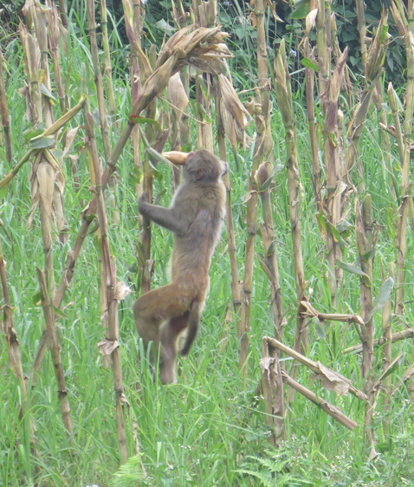
Human wildlife conflicts
How much does the density of animals impact crop yields?
Do some species cause more damage at the same density?
Different species damage plants in different ways
Individuals of different species can eat different volumes of food
How would you attempt to answer this?

Slide 6
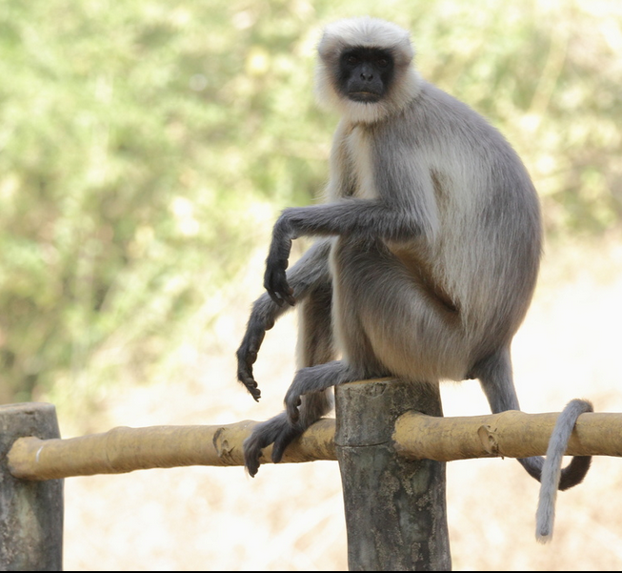
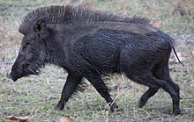
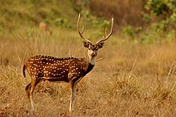
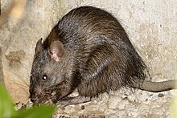
How much crop?
Experimental approach
Four Indian herbivores
  Indian boar (Sus scrofa cristatus)
  Chital (Axis axis)
  Greater bandicoot rat (Bandicota indica)
  Malabar Gray Lenagur (Semnopithecus hypoleucos)
Controlled density of each species in each plot
Measure yield of crop (response)
We want to understand how each species and their densities influences crop yield
So, crop ~ species + density?
Species
Crop
Yield
Density

Slide 7
The data

Slide 8
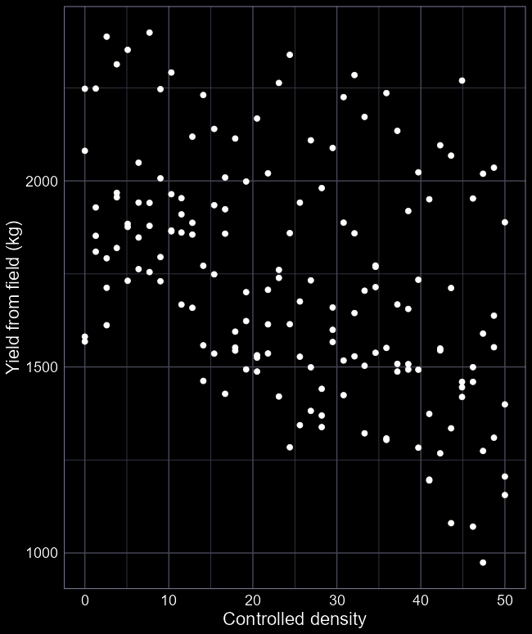
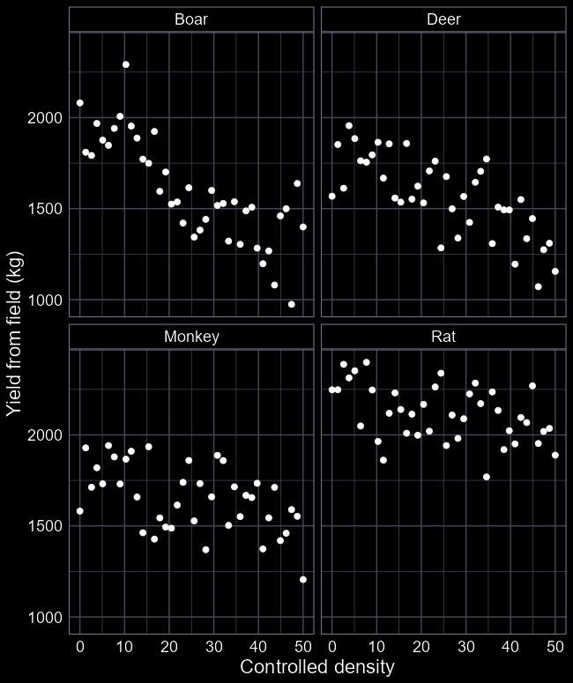
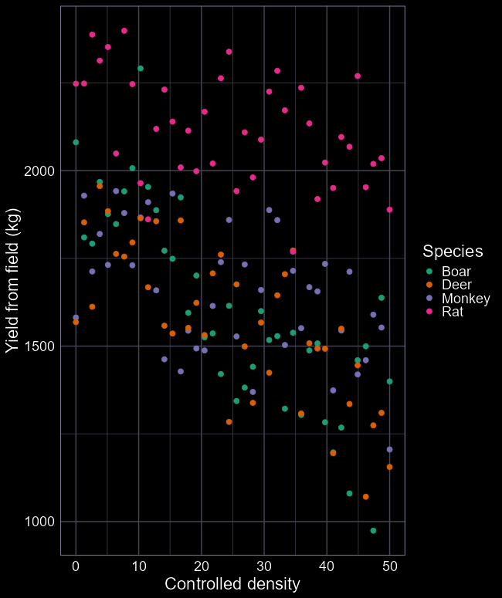
Exploratory data analysis
As always start with EDA:
  Notice anything weird?
  Any surprises or concerns?
Is this the best way to visualise the data?
  Our question is if the relationship differs between species
  We can show this with colour
  Or with facets (clearer?)
What do you see?

Slide 9
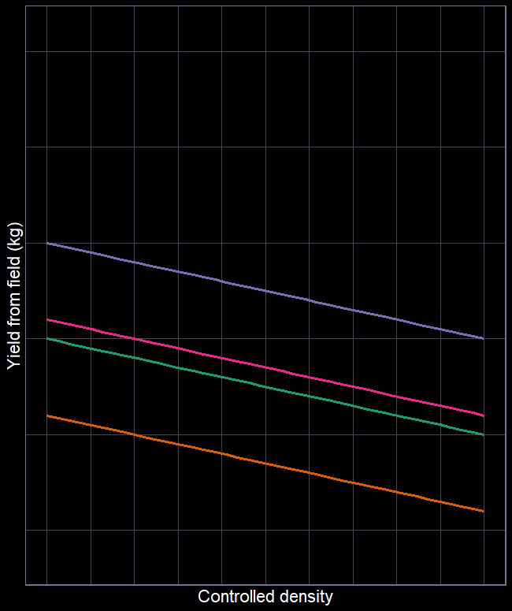
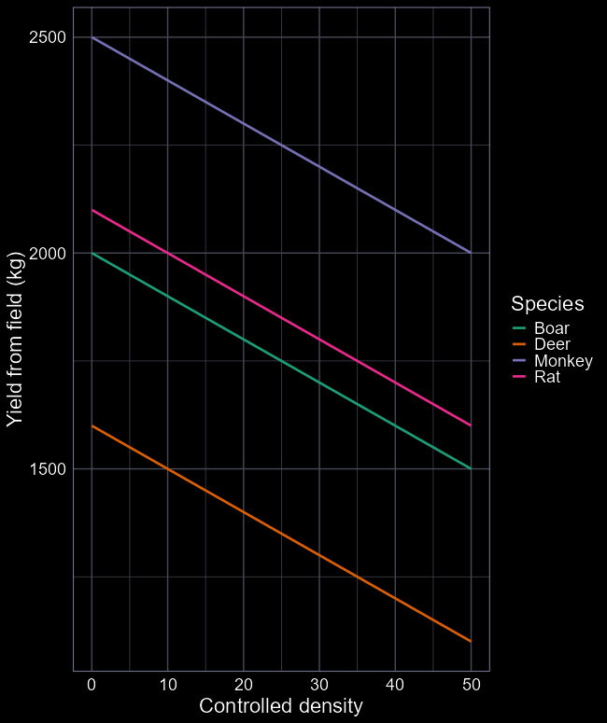








What might the results look like?
$$β_{2}$$
crop ~ species + density
  $μ=β_{0}+β_{1}D_{i}+β_{2}M_{i}+β_{3}R_{i}+β_{4}Dens_{i}$
By including species, we allow for each species to have their own intercept ($β_{0,…,3})$
But we only have a single parameter to describe density, so all species have the same slope ($β_{4}$)
The lines will always be parallel
Does that make biological sense, and does it answer our question?
$$β_{4}$$
$$β_{3}$$
$$β_{0}$$
$$β_{1}$$
$$β_{4}$$
$$β_{4}$$

Slide 10
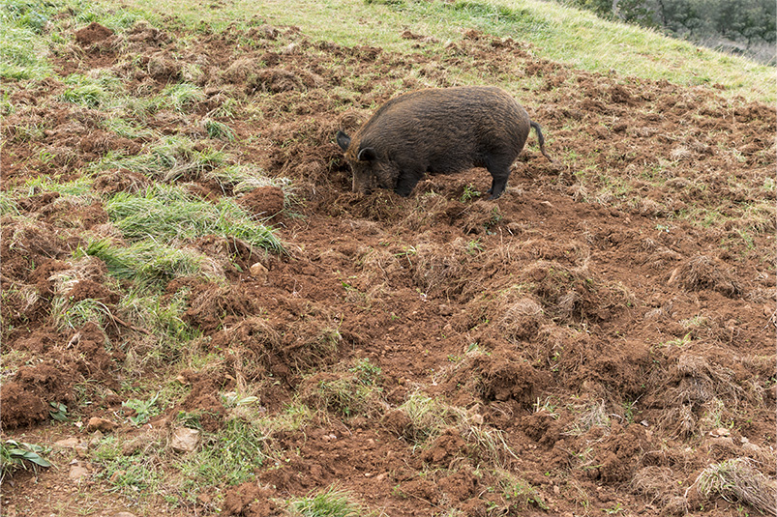
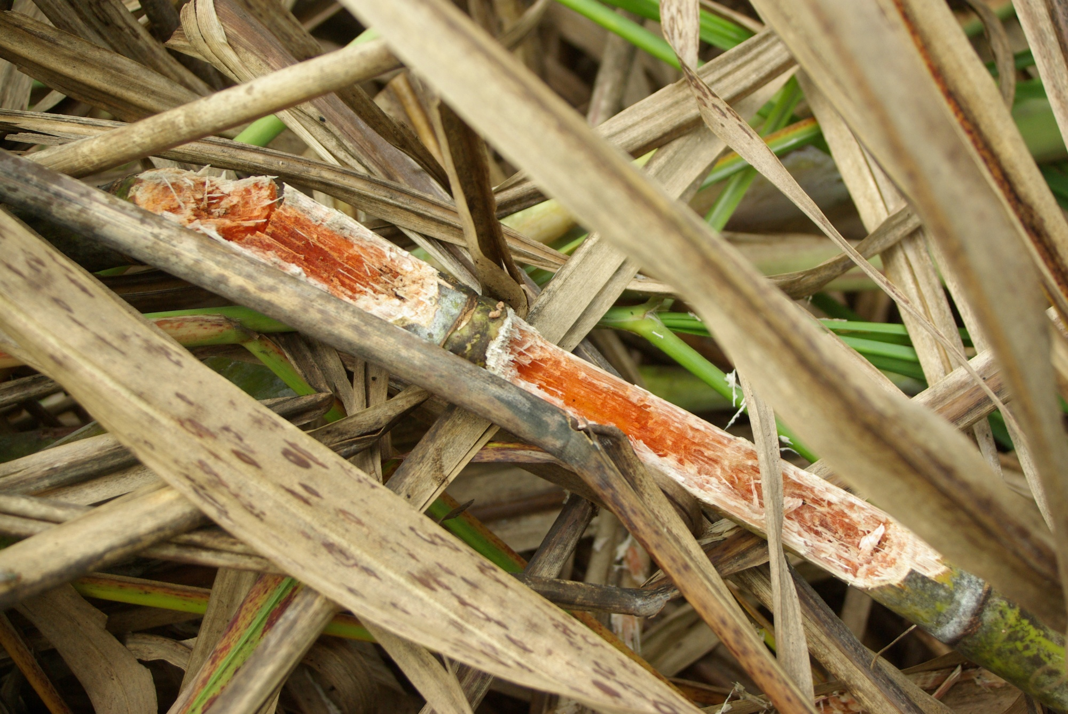
Biological sense?
Species clearly differ
The damage done by an individual of each species clearly differ
  One boar eats a lot more than one rat
  Having 1,000 boar in your field is not the same as 1,000 rats
Surely the slopes for each species could be different?

Slide 11

How do we say 1 rat $≠$ 1 boar?

Slide 12

Is my coffee sweet?
Using only the following information, tell me if my cup of coffee is sweet or not

Slide 13
Is my coffee sweet?
Scenario 1
I stir my coffee with a spoon

Slide 14
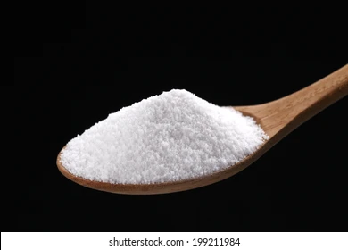
Is my coffee sweet?
Scenario 2
I add sugar to my coffee

Slide 15
Is my coffee sweet?
Scenario 3
Sometimes I add sugar to my coffee
Sometimes I stir my coffee

Slide 16
Is my coffee sweet?
Scenario 4
I have added sugar to my coffee
And at the same time
I have stirred the coffee
and

Slide 17
Is my coffee sweet?
To answer question you need to know both pieces of information
  But just knowing that sometimes I stir and sometimes I add sugar doesn’t actually help very much
We need to know if both adding sugar and stirring occurred at the same time
How do we tell the model this?

Slide 18
What is an interaction?
Will my tea be sweet?
  Sweet ~ sugar + stir
The model doesn’t know that the effectiveness of adding sugar depends on stirring and vice versa
  What if I stirred, but didn’t add sugar?
Treats both variables as being independent of each other
Maybe
sweet?
Maybe
sweet?
Not Sweet
Not Sweet

Slide 19
What is an interaction?
Interactions specify that an outcome is a result of specific combinations of more than one variable
The effectiveness of a covariate, depends on another covariate
  Sweet ~ sugar * stir
Sweet
Not Sweet
Not Sweet
Not Sweet

Slide 20
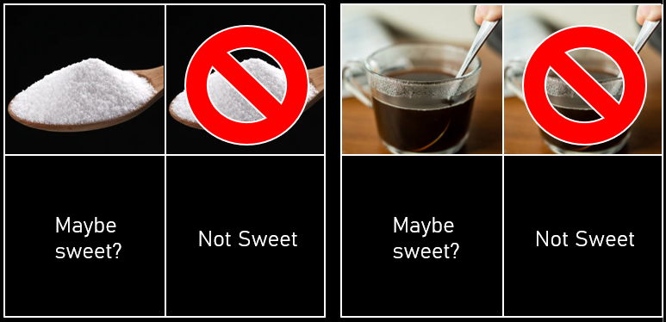
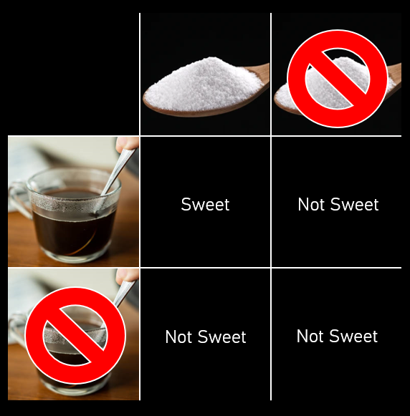

Two ways to specify interactions
The “formal” option
  Sweet ~ sugar + stir
  + sugar : stir
  $μ_{i}=β_{0}+β_{1}×S_{i}+β_{2}×T_{i}$
  $+ β_{3}×S_{i}×T_{i}$
The “shortcut” option
  Sweet ~ sugar * stir
  $μ_{i}=β_{0}+β_{1}×S_{i}+β_{2}×T_{i}$
  $+ β_{3}×S_{i}×T_{i}$

Slide 21
How do we say 1 rat $≠$ 1 boar?

Slide 22
Species
Crop
Yield
Density

Slide 23
The question
How much does density impact crop yields, and does this vary by species?
We want to use an interaction to specify that the impact of density on yield differs between species:
crop ~ species * density
Species
Crop
Yield
Density

Slide 24
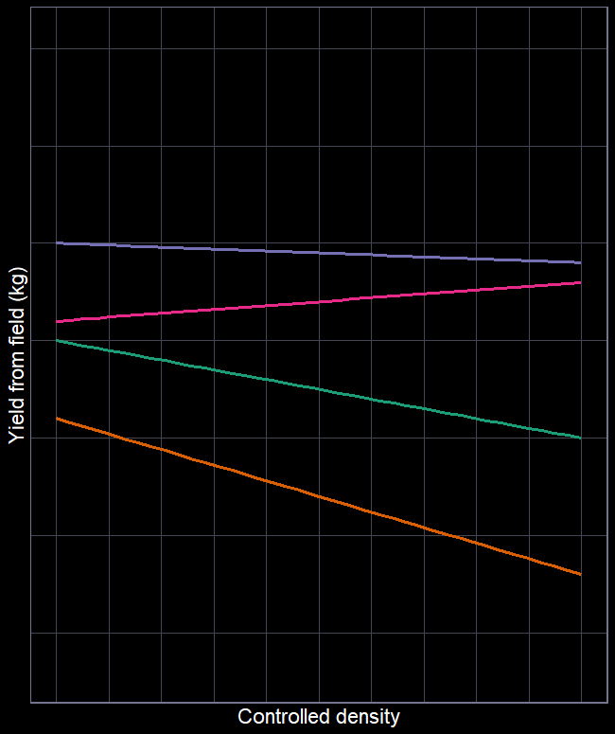
species * density
We expand on species + density
By using an interaction
Each species’ intercept can still be different
But the relationship with density can also be species specific

Slide 25
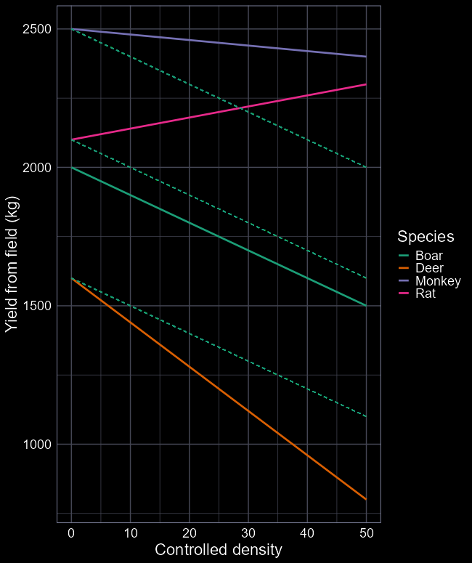
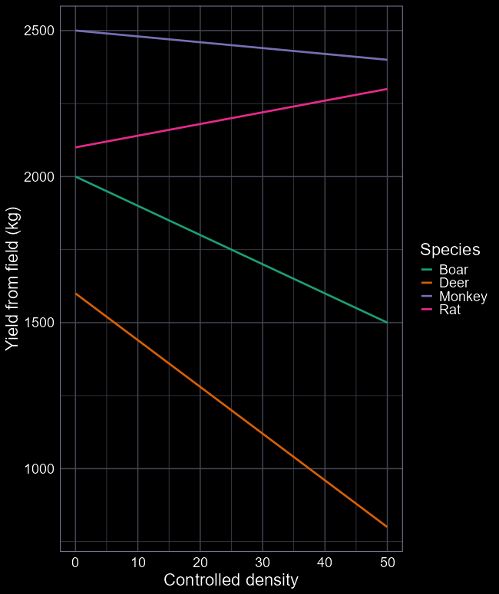




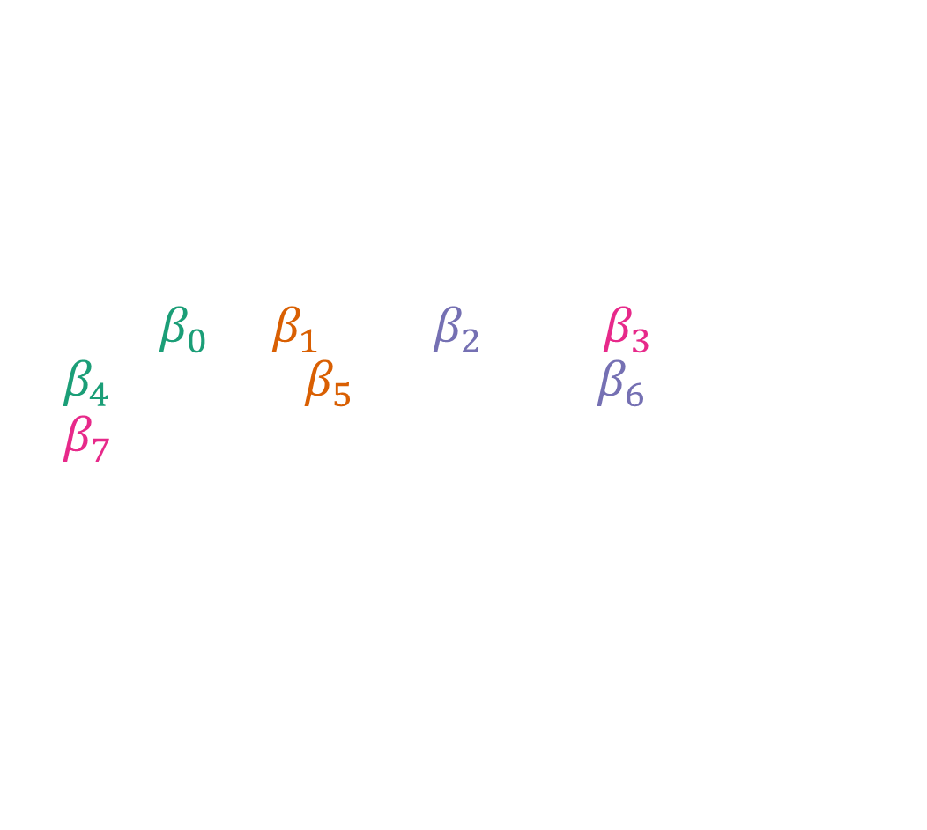




Interactions
$$β_{2}$$
$$β_{6}$$
We started with just additive terms:
$μ=β_{0}+β_{1}D_{i}+β_{2}M_{i}+β_{3}R_{i}+β_{4}Dens_{i}$
Now we include the interactions:
$μ=β_{0}+β_{1}D_{i}+β_{2}M_{i}+β_{3}R_{i}+β_{4}Dens_{i}+β_{5}D_{i}Dens_{i}+β_{6}M_{i}Dens_{i}+β_{7}R_{i}Dens_{i}$
Just as $β_{1,…, 3}$ are the difference in averages compared to the intercept
$β_{5,…,7}$ are the difference in slope compared to the baseline slope ($β_{4}$)
$$β_{7}$$
$$β_{3}$$
$$β_{0}$$
$$β_{1}$$
$$β_{4}$$
$$β_{5}$$

Slide 26
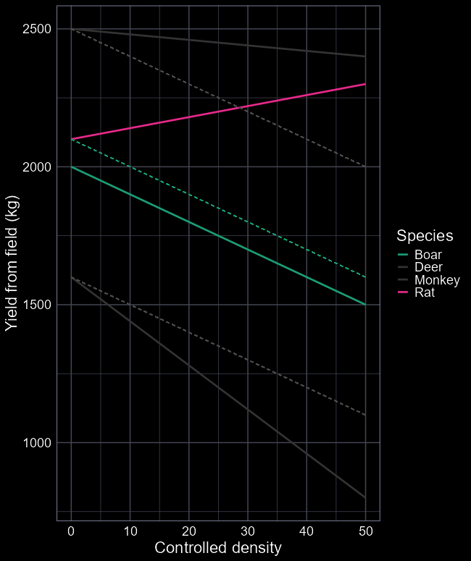







Quiz
$$β_{2}$$
$$β_{6}$$
Starting with our equation:
$μ=β_{0}+β_{1}D_{i}+β_{2}M_{i}+β_{3}R_{i}+β_{4}Dens_{i}+β_{5}D_{i}Dens_{i}+β_{6}M_{i}Dens_{i}+β_{7}R_{i}Dens_{i}$
Assume we have 5 Rats in the field
  $R_{i}=1$ (for “Yes” this observation is Rat)
  $Dens_{i}=5$ (density is 5)
$μ= β_{0}+β_{1}×0+β_{2}×0+β_{3}×1+β_{4}×5+β_{5}×0×5 +β_{6}×0×5+β_{7}×1×5$
$β_{0}+β_{3}×1+ β_{4}×5+β_{7}×1×5$
$$β_{7}$$
$$β_{3}$$
$$β_{0}$$
$$β_{1}$$
$$β_{4}$$
$$β_{5}$$

Slide 27

Quiz
Assume we have 15 Malabar Gray Lenagurs
What is the “simplified” equation which would describe the average yield?
$μ=β_{0}+β_{1}D_{i}+β_{2}M_{i}+β_{3}R_{i}+β_{4}Dens_{i}+β_{5}D_{i}Dens_{i}+β_{6}M_{i}Dens_{i}+β_{7}R_{i}Dens_{i}$
$μ=β_{0}+β_{1}×15+β_{2}×1+β_{4}×15+β_{6}×1×15$

Slide 28
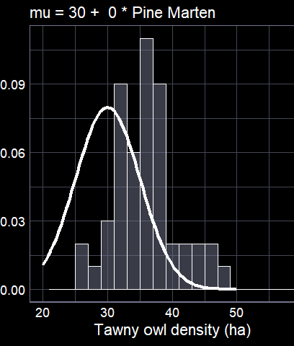

Model fitting
The background machinery is the same as always
R tweaks the parameter values of our equation, so that the idealised $Normal$distribution overlaps the real data as close as possible
  (It becomes a real pain to visualise this with complex models)

Slide 29
Diagnose

Slide 30
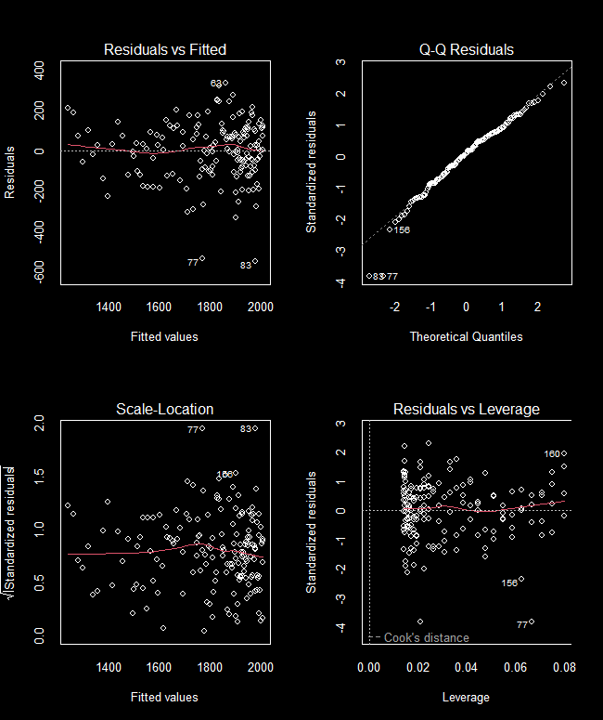
Diagnose
When running models with lots of explanatory variables, these diagnostic figures become incredibly valuable
Condense information down to be digestible
All four plots look great
On to interpretation!

Slide 31
Inference

Slide 32
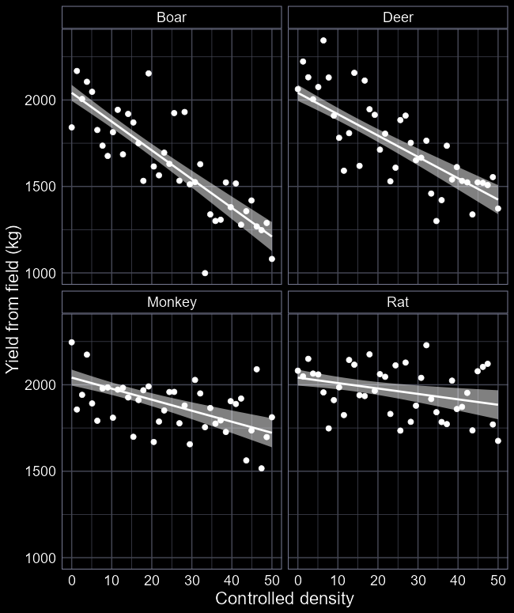
What do we learn?
Coefficients:
Estimate Std. Error
(Intercept) 2032.722 46.980
speciesDeer 78.767 66.439
speciesMonkey -47.966 66.439
speciesRat 3.685 66.439
density -16.371 1.617
speciesDeer:density 1.943 2.287
speciesMonkey:density 11.666 2.287
speciesRat:density 13.376 2.287
Which species is acting as our (Intercept)?
What yield do we expect for Deer when density is zero?
Is there meaningful difference in
Does that make biological sense?
Which species lowers yield the most?
Do any species increase yield?

Slide 33
Advice to farmers?
Main species of concern are clearly boar
Rats are not a problem
Focus efforts to keep boars out of field

Slide 34
Dangers when making inference

Slide 35
A complication
This data comes from an experiment
Great right?
Any limitations?
How often do you get 50 individuals of each species?
What kind of densities do the different species occur at?
https://www.youtube.com/watch?v=zWVw-j8eYSk
What if we reran the experiment but used sensible range of densities?

Slide 36
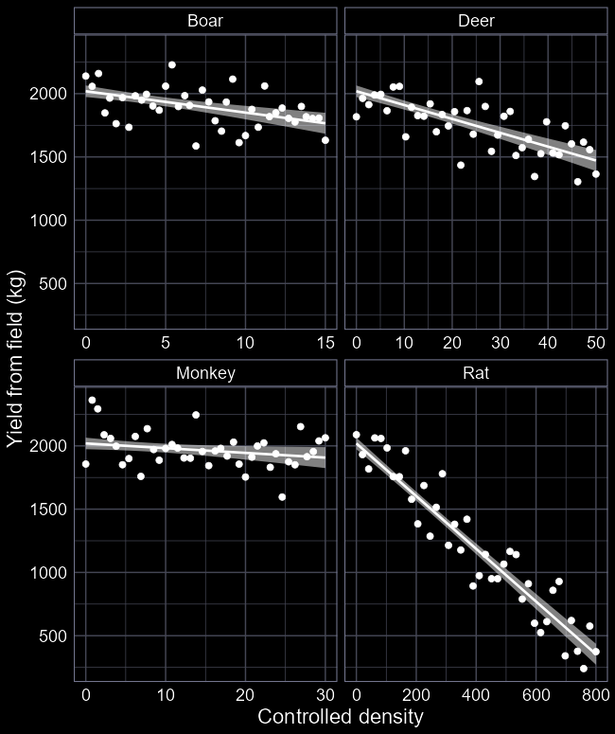
Advice to farmers, now?
With a more biologically sensible experimental design, we learn:
Rats are the biggest problem by far
Per individual, they don’t do much to yield
But they can reach insanely high densities
“Quantity over quality”
What advice do we give now?
  Focus efforts to reduce rat density

Slide 37
Flavours of interactions

Slide 38
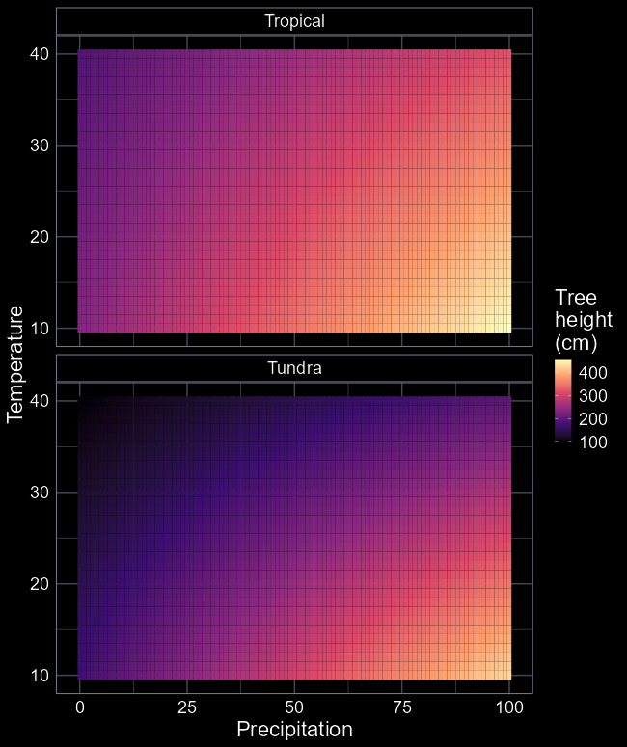
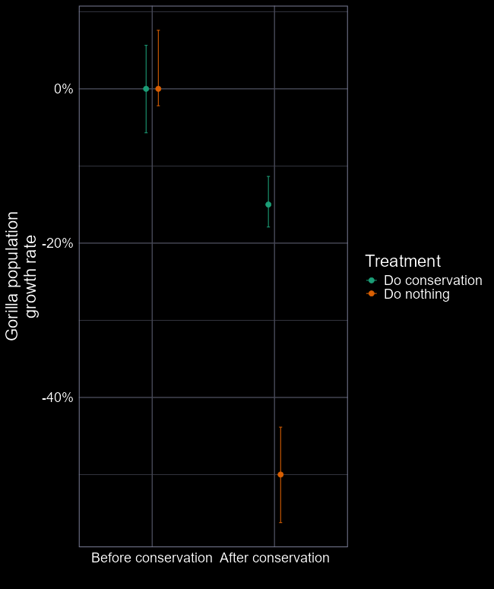
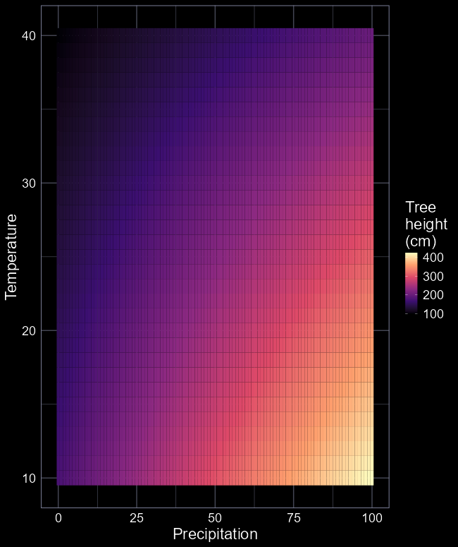
Flavours of interactions
In the previous example we used an interaction between a categorical and a continuous
But you can have interactions between:
  Two categorical variables
  Two continuous variables
Or interactions with more than two variables
  For example, two continuous and one categorical

Slide 39
Warning
Interactions are incredibly expensive
The number of parameters can quickly get out of control
  Especially true for categorical variables
  Gorilla example needs 4 parameters
  The 3-way example needs 8 parameters
Interactions require sample sizes up to 16 times larger to fit

Slide 40
tl;dr
We always start with a question
Statistics is merely how we answer the question
Start by plotting your data – get a feel for what’s going on
  Also really useful to draw your data generating process
Run your model, including variables you think are appropriate
  If you think the response variable is influenced by the combined values of two or more explanatory variables, include as an interaction
Interpret what those parameter values mean biologically
Visualise the results

